Slide 1
Housing Project

Slide 2
Problem Statement-
Build a model using Machine Learning in order to predict the actual value of the prospective properties and decide whether to invest in them or not . This model will then be used by the management to understand how exactly the prices of the houses vary with the available independent variables. They can accordingly manipulate the strategy of the firm and concentrate on areas that will yield high returns. Further, the model will be a good way for the management to understand the pricing dynamics of a new market

Slide 3
Problem Understanding-
Houses are one of the necessary need of each and every person around the globe and therefore housing and real estate market is one of the markets which is one of the major contributors in the world’s economy. Data science comes as a very important tool to solve problems in the domain to help the companies increase their overall revenue, profits, improving their marketing strategies and focusing on changing trends in house sales and purchases.
A US-based housing company named Surprise Housing has decided to enter the Australian market. The company uses data analytics to purchase houses at a price below their actual values and flip them at a higher price. The company is looking at prospective properties to buy houses to enter the market.
The model build using Machine Learning should predict the actual value of the prospective properties and decide whether to invest in them or not

Slide 4
EDA Steps and Visualization

Slide 5
The train datasheet is extracted and saved in a dataframe
The shape of the dataframe is checked-
There are 1168 rows and 81 columns
The columns areas follows-

Slide 6
OverallCond
YearBuilt
YearRemodAdd
RoofStyle
RoofMatl
Exterior1st
Exterior2nd
MasVnrType
MasVnrArea
ExterQual
ExterCond
Foundation
BsmtQual
BsmtCond
BsmtExposure
BsmtFinType1
BsmtFinSF1
BsmtFinType2
BsmtFinSF2
BsmtUnfSF
TotalBsmtSF
Heating
HeatingQC
CentralAir
Electrical
1stFlrSF
2ndFlrSF
LowQualFinSF
GrLivArea
BsmtFullBath
BsmtHalfBath
FullBath
HalfBath
BedroomAbvGr
KitchenAbvGr
KitchenQual
TotRmsAbvGrd
Functional
Fireplaces
FireplaceQu
GarageType
GarageYrBlt
GarageFinish
GarageCars
GarageArea
GarageQual
GarageCond
PavedDrive
WoodDeckSF
OpenPorchSF
EnclosedPorch
3SsnPorch
ScreenPorch
PoolArea
PoolQC
Fence
MiscFeature
MiscVal
MoSold
YrSold
SaleType
SaleCondition
SalePrice
Id
MSSubClass
MSZoning
LotFrontage
LotArea
Street
Alley
LotShape
LandContour
Utilities
LotConfig
LandSlope
Neighborhood
Condition1
Condition2
BldgType
HouseStyle
OverallQual

Slide 7
The data type of each column is-
Id ---------------- int64
MSSubClass ---------------- int64
MSZoning ---------------- object
LotFrontage ---------------- float64
LotArea ---------------- int64
Street ---------------- object
Alley ---------------- object
LotShape ---------------- object
LandContour ---------------- object
Utilities ---------------- object
LotConfig ---------------- object
LandSlope ---------------- object
Neighborhood ---------------- object
Condition1 ---------------- object
Condition2 ---------------- object
BldgType ---------------- object
HouseStyle ---------------- object
OverallQual ---------------- int64
OverallCond ---------------- int64 Y
earBuilt ---------------- int64
YearRemodAdd ---------------- int64
RoofStyle ---------------- object
RoofMatl ---------------- object
Exterior1st ---------------- object
Exterior2nd ---------------- object
MasVnrType ---------------- object
MasVnrArea ---------------- float64
ExterQual ---------------- object
ExterCond ---------------- object
Foundation ---------------- object
BsmtQual ---------------- object
BsmtCond ---------------- object
BsmtExposure ---------------- object
BsmtFinType1 ---------------- object
BsmtFinSF1 ---------------- int64
BsmtFinType2 ---------------- object
BsmtFinSF2 ---------------- int64
BsmtUnfSF ---------------- int64
TotalBsmtSF ---------------- int64
Heating ---------------- object
HeatingQC ---------------- object
CentralAir ---------------- object
Electrical ---------------- object
1stFlrSF ---------------- int64
2ndFlrSF ---------------- int64
LowQualFinSF ---------------- int64
GrLivArea ---------------- int64
BsmtFullBath ---------------- int64
BsmtHalfBath ---------------- int64
FullBath ---------------- int64
HalfBath ---------------- int64
BedroomAbvGr ---------------- int64
KitchenAbvGr ---------------- int64
KitchenQual ---------------- object
TotRmsAbvGrd ---------------- int64
Functional ---------------- object
Fireplaces ---------------- int64
FireplaceQu ---------------- object
GarageType ---------------- object
GarageYrBlt ---------------- float64
GarageFinish ---------------- object
GarageCars ---------------- int64
GarageArea ---------------- int64
GarageQual ---------------- object
GarageCond ---------------- object
PavedDrive ---------------- object
WoodDeckSF ---------------- int64
OpenPorchSF ---------------- int64
EnclosedPorch ---------------- int64
3SsnPorch ---------------- int64
ScreenPorch ---------------- int64
PoolArea ---------------- int64
PoolQC ---------------- object
Fence ---------------- object
MiscFeature ---------------- object
MiscVal ---------------- int64
MoSold ---------------- int64
YrSold ---------------- int64
SaleType ---------------- object
SaleCondition ---------------- object
SalePrice ---------------- int64

Slide 8
The null values are present in the following columns-
Column | No of null values
LotFrontage | 214
Alley | 1091
MasVnrType | 7
MasVnrArea | 7
BsmtQual | 30
BsmtCond | 30
BsmtExposure | 31
BsmtFinType1 | 30
BsmtFinType2 | 31
FireplaceQu | 551
GarageType | 64
GarageYrBlt | 64
GarageFinish | 64
GarageQual | 64
GarageCond | 64
PoolQC | 1161
Fence | 931
MiscFeature | 1124

Slide 9
The data visualization, value counts encoding and imputation of null values for each column

Slide 10
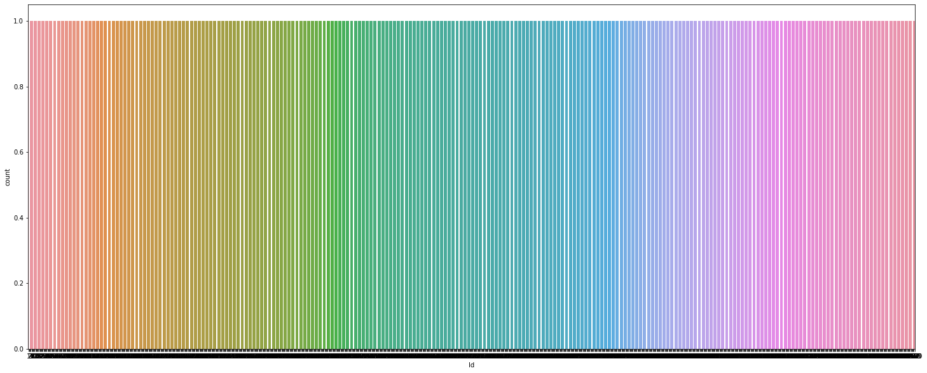
ID
As the id is unique to all, its safe to drop this column

Slide 11
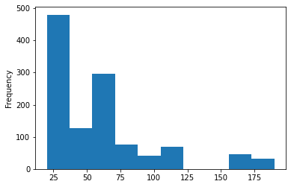
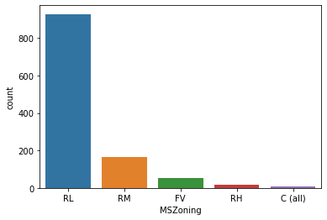
MSSubClass
Identifies the type of dwelling involved in the sale.
MSZoning
Identifies the general zoning classification of the sale.
428 properties are 20 (1-STORY 1946 & NEWER ALL STYLES)
244 properties are 60 (2-STORY 1946 & NEWER)
113 properties are 50 (1-1/2 STORY FINISHED ALL AGES)
69 properties are 120 (1-STORY PUD (Planned Unit Development) –
1946 & NEWER)
53 properties are 70 (2-STORY 1945 & OLDER)
52 properties are 30 (1-STORY 1945 & OLDER)
47 properties are 160 (2-STORY PUD - 1946 & NEWER)
43 properties are 80 (SPLIT OR MULTI-LEVEL)
41 properties are 90 (DUPLEX - ALL STYLES AND AGES)
26 properties are 190 (2 FAMILY CONVERSION - ALL STYLES AND AGES)
19 properties are 85 (SPLIT FOYER)
14 properties are 75 (2-1/2 STORY ALL AGES)
10 properties are 45 (1-1/2 STORY - UNFINISHED ALL AGES)
6 properties are 180 (PUD - MULTILEVEL - INCL SPLIT LEV/FOYER)
3 properties are 40 (1-STORY W/FINISHED ATTIC ALL AGES)
928 properties are RL (Residential Low Density)
163 properties are RM (Residential Medium Density)
52 properties are FV (Floating Village Residential)
16 properties are RH (Residential High Density)
9 properties are C (Commercial)
Encoding object data in numeric using Label Encoder

Slide 12
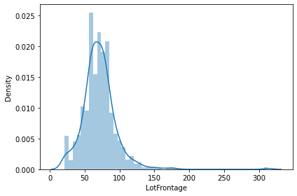
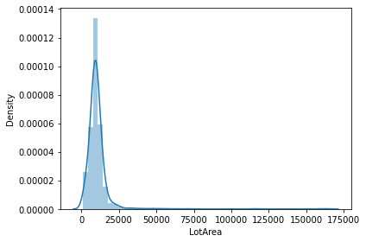
LotFrontage
Linear feet of street connected to property
LotArea
Lot size in square feet
111 properties have LotFrontage of 60
21 properties have LotArea of 9600
The data is slightly skewed and will be transformed later
The data is skewed and will be transformed later

Slide 13
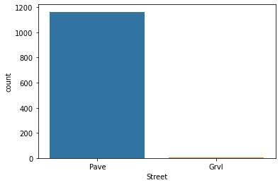
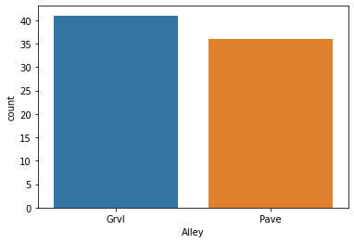
Street
Type of road access to property
Alley
Type of alley access to property
1164 properties have Pave (paved) road
4 properties have Grvl (gravel) road
1091 have No alley access
41 have Grvl (Gravel) alley
36 have Pave (paved) alley
Encoding object data in numeric using Label Encoder
Encoding object data in numeric using Label Encoder

Slide 14
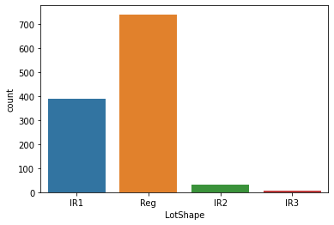
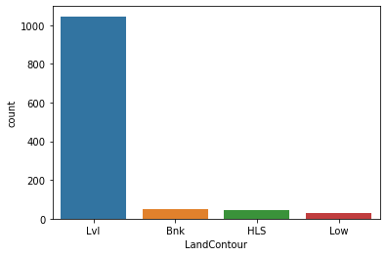
LotShape
General shape of property
LandContour
Flatness of the property
1046 properties are Lvl (Near Flat/Level)
50 properties are Bnk (Banked - Quick and significant rise from street grade to building)
42 properties are HLS (Hillside - Significant slope from side to side)
30 properties are Low depression
740 properties are Reg (Regular)
390 properties are IR1 (Slightly Irregular)
32 properties are IR2 ( Moderately irregular)
6 properties are IR3 (Irregular)
Encoding object data in numeric using Label Encoder
Encoding object data in numeric using Label Encoder

Slide 15
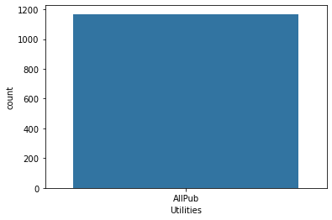
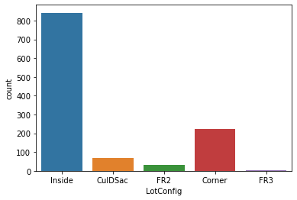
LotConfig
Lot configuration
Utilities
1168 properties have AllPub [All public Utilities (E,G,W,& S)]
842 properties are inside lot
222 properties are corner lot
69 properties are Cul-de-sac
33 properties are Frontage on 2 sides of property
2 properties are Frontage on 3 sides of property
As all properties have the same utilities, its safe to drop this column
Encoding object data in numeric using Label Encoder

Slide 16
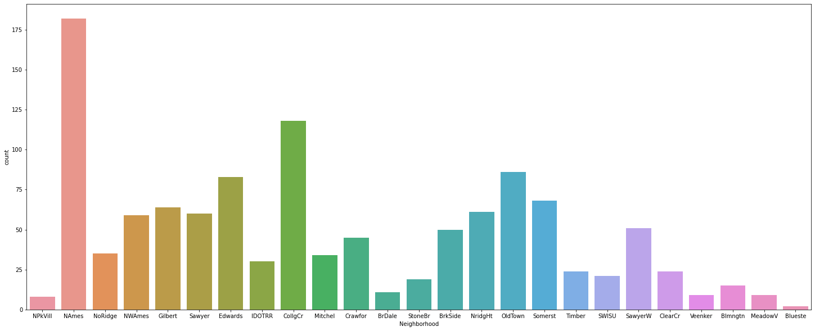
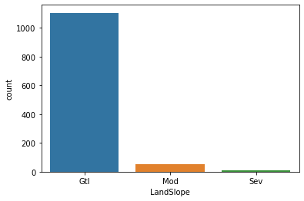
LandSlope
Slope of property
Neighborhood
Physical locations within Ames city limits
182 properties are in Names (North Ames)
118 properties are in CollgCr (College Creek)
86 properties are in OldTown
83 properties in Edwards
68 properties are in Somerst
64 properties are in Gilbert
61 properties are in NridgHt (Northridge Heights)
60 properties are in Sawyer
59 properties are in NWAmes (Northwest Ames)
51 properties are in SawyerW (Sawyer West)
50 properties are in BrkSide (Brookside)
45 properties are in Crawfor (Crawford)
35 properties are in NoRidge (Northridge)
34 properties are in Mitchel
30 properties are in IDOTRR (Iowa DOT and Rail Road)
24 properties are in Timber (Timberland)
24 properties are in ClearCr (Clear Creek)
21 properties are in SWISU (South & West of Iowa State University)
19 properties are in Stone Brook
15 properties are in Blmngtn (Bloomington Heights)
11 properties are in BrDale (Briardale)
9 properties are in MeadowV (Meadow Village)
9 properties are in Veenker
8 properties are in NPkVill (Northpark Villa)
2 properties are in Blueste (Bluestem)
1105 properties have Gtl (Gentle slope)
51 properties have Mod (Moderate slope)
12 properties have Sev (Severe slopes)
Encoding object data in numeric using Label Encoder
Encoding object data in numeric using Label Encoder

Slide 17
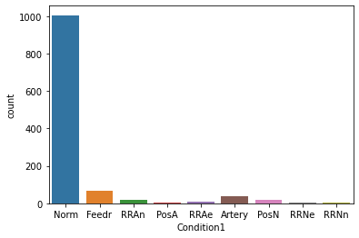
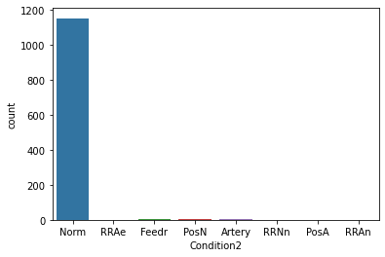
Condition1
Proximity to various conditions
Condition2
Proximity to various conditions (if more than one is present)
1005 properties are Norm (Normal)
67 properties are Feedr (Adjacent to feeder street)
38 properties are Artery (Adjacent to arterial street)
20 properties are RRAn (Adjacent to North-South Railroad)
17 properties are PosN (Near positive off-site feature--park, greenbelt, etc)
9 properties are RRAe (Adjacent to East-West Railroad)
6 properties are PosA (Adjacent to postive off-site feature)
4 properties are RRNn (Within 200' of North-South Railroad)
2 properties are RRNe (Within 200' of East-West Railroad)
1154 properties are Norm (Normal)
6 properties are Feedr (Adjacent to feeder street)
2 properties are PosN (Near positive off-site feature--park, greenbelt, etc)
2 properties are Artery (Adjacent to arterial street)
1 property is RRAe (Adjacent to East-West Railroad)
1 property is RRNn (Within 200' of North-South Railroad)
1 property is PosA (Adjacent to postive off-site feature)
1 property is RRAn (Adjacent to North-South Railroad)
Encoding object data in numeric using Label Encoder
Encoding object data in numeric using Label Encoder

Slide 18
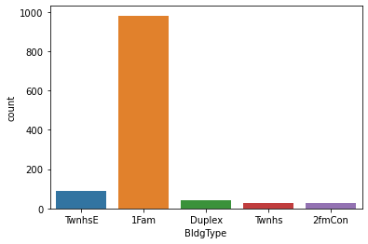
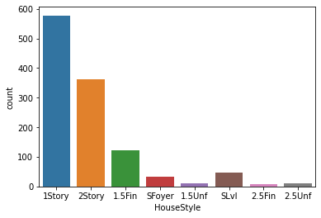
BldgType
Type of dwelling
HouseStyle
Style of dwelling
578 properties are 1Story (One story)
2Story 361
121 properties are 1.5Fin (One and one-half story: 2nd level finished)
47 properties are SLvl (Split Level )
32 properties are SFoyer (Split Foyer)
12 properties are 1.5Unf (One and one-half story: 2nd level unfinished)
10 properties are 2.5Unf (Two and one-half story: 2nd level unfinished)
7 properties are 2.5Fin (Two and one-half story: 2nd level finished)
981 properties are 1Fam (Single-family Detached)
90 properties are TwnhsE (Townhouse End Unit)
41 properties are Duplex
29 properties are Twnhs (Townhouse Inside Unit )
27 properties are 2fmCon (Two-family Conversion; originally built as one-family dwelling)
Encoding object data in numeric using Label Encoder
Encoding object data in numeric using Label Encoder

Slide 19
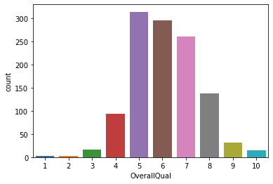
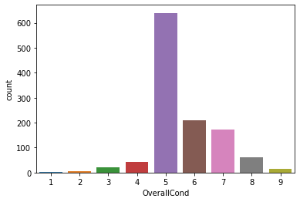
OverallQual
Rates the overall material and finish of the house
OverallCond
Rates the overall condition of the house
314 properties are rated 5 (Average)
295 properties are rated 6 (Above average)
260 properties are rated 7 (Good)
138 properties are rated 8 (Very good)
93 properties are rated 4 (Below average)
32 properties are rate 9 (Excellent)
16 properties are rated 3 (Fair)
15 properties are rated 10 (Very excellent)
3 properties are rated 2 (Poor)
2 properties are rated 1 (Very poor)
640 properties are rated 5 (Average)
209 properties are rated 6 (Above average)
172 properties are rated 7 (Good)
61 properties are rated 8 (Very good)
43 properties are rated 4 (Below average)
21 properties are rated 3 (Fair)
16 properties are rated 9 (Excellent)
5 properties are rated 2 (Very poor)
1 properties are rated 1 (Very poor)

Slide 20
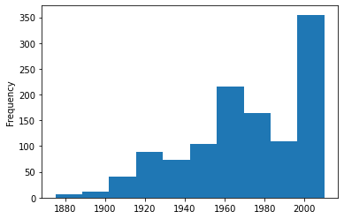
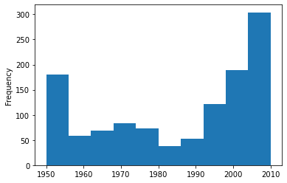
YearRemodAdd
Remodel date (same as construction date if no remodeling or additions)
YearBuilt
Original construction date
Majority of the properties are built in 2000
Majority of the properties are built in 2010

Slide 21
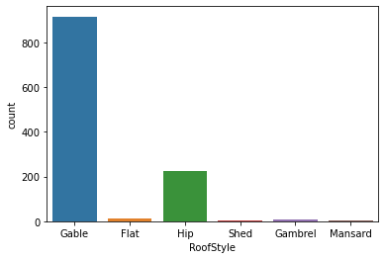
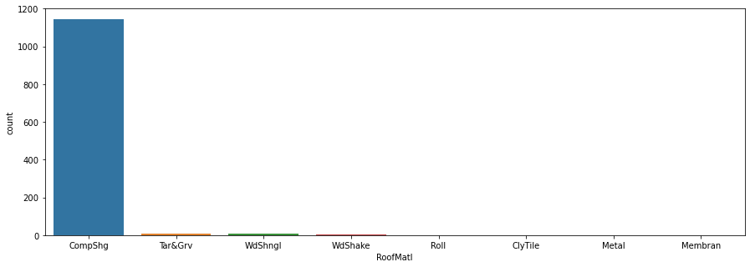
RoofStyle
Type of roof
RoofMatl
Roof material
915 properties have gable roof
225 properties have hip roof
12 properties have flat roof
9 properties have gambrel roof
5 properties have mansard roof
2 properties have shed roof
1144 properties have CompShg (standard(composite) shingle) roof
10 properties have Tar&Grv (gravel & Tar) roof
6 properties have WdShngl (wood shingles) roof
4 properties have WdShake (wood shakes) roof
1 property has Roll roof
1 property has ClyTile (clay or tile) roof
1 property has Metal roof
1 property has Membrane roof
Encoding object data in numeric using Label Encoder
Encoding object data in numeric using Label Encoder

Slide 22
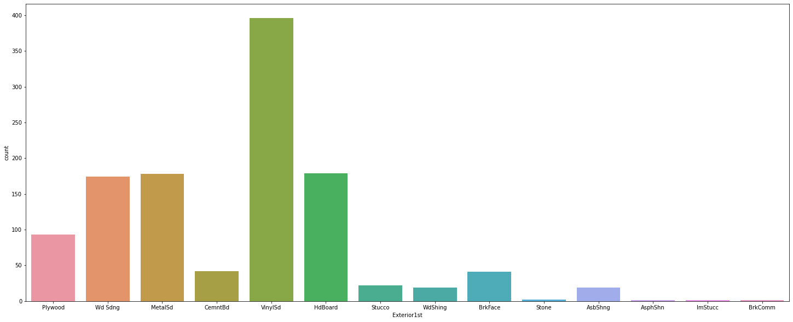
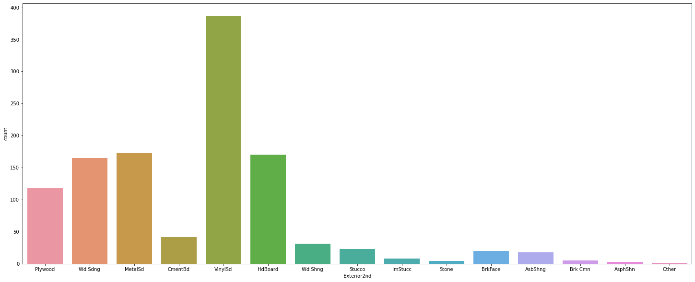
Exterior1st
Exterior covering on house
Exterior2nd
Exterior covering on house (if more than one material)
396 properties have VinylSd (Vinyl Siding) exterior
179 properties have HdBoard (Hard Board) exterior
178 properties have MetalSd (Metal Siding) exterior
174 properties have Wd Sdng (Wood Siding) exterior
93 properties have Plywood exterior
42 properties have CemntBd (Cement Board) exterior
41 properties have BrkFace (Brick Face) exterior
22 properties have Stucco exterior
19 properties have WdShing (Wood Shingles) exterior
19 properties have AsbShng (Asbestos Shingles) exterior
2 properties have Stone exterior
1 property has AsphShn (Asphalt Shingles) exterior
1 property has ImStucc (Imitation Stucco) exterior
1 property has BrkComm (Brick Common) exterior
387 properties have VinylSd (Vinyl Siding) exterior
173 properties have MetalSd (Metal Siding) exterior
170 properties have HdBoard (Hard Board) exterior
165 properties have Wd Sdng (Wood Siding) exterior
118 properties have Plywood exterior
42 properties have CmentBd (Cement Board) exterior
31 properties have Wd Shng (Wood Shingles) exterior
23 properties have Stucco exterior
20 properties have BrkFace (Brick face) exterior
18 properties have AsbShng (Asbestos Shingles) exterior
8 properties have ImStucc (Imitation Stucco) exterior
5 properties have Brk Cmn (Brick Common) exterior
4 properties have Stone exterior
3 properties have AsphShn (Asphalt Shingles) exterior
1 property has other exterior
Encoding object data in numeric using Label Encoder
Encoding object data in numeric using Label Encoder

Slide 23
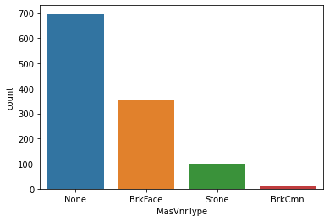
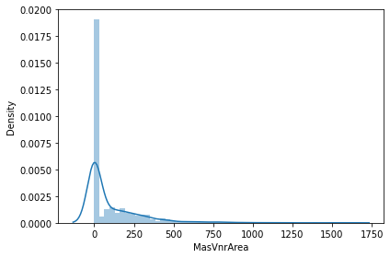
MasVnrType
Masonry veneer type
MasVnrArea
Masonry veneer area in square feet
None 696 properties lack masonry veneer
354 properties have BrkFace (Brick Face) masonry veneer
98 properties have Stone masonry veneer
13 properties have BrkCmn (Brick Common) masonry veneer
692 properties have lack masonries hence the area is 0
Encoding object data in numeric using Label Encoder
The data is skewed and will be transformed later
Replacing null value with the mode of the column

Slide 24
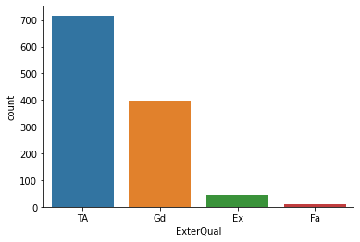
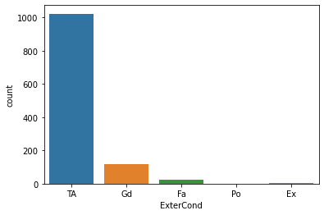
ExterQual
Evaluates the quality of the material on the exterior
ExterCond
Evaluates the present condition of the material on the exterior
717 properties have TA (average/typical) exterior
397 properties have Gd (good) exterior
43 properties have Ex (Excellent) exterior
11 properties have Fa (fair) exterior
1022 properties have TA (average/typical) exterior
117 properties have Gd (good) exterior
26 properties have (fair) exterior
2 properties have Ex (excellent) exterior
1 property has Po (poor) exterior
Encoding object data in numeric using Label Encoder
Encoding object data in numeric using Label Encoder

Slide 25
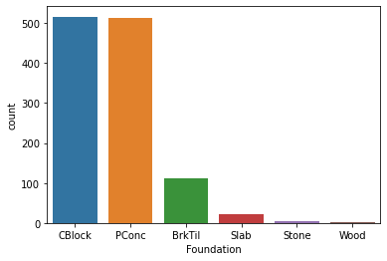
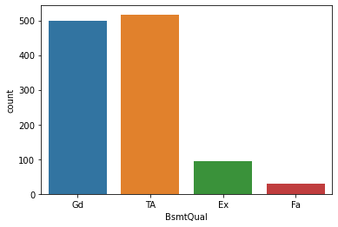
Foundation
Type of foundation
BsmtQual
Evaluates the height of the basement
516 properties have Cblock (Cinder Block) foundation
513 properties have Pconc (Poured Contrete) foundation
112 properties have BrkTil (Brick & Tile) foundation
21 properties have Slab foundation
5 properties have Stone foundation
1 property has wood foundation
517 properties have TA (typical (80-89 inches)) basement height)
498 properties have Gd (good (90-99 inches) basement height)
94 properties have Ex (excellent (100+ inches) basement height)
29 properties have Fa (fair (70-79 inches) basement height)
30 properties have No basement
Encoding object data in numeric using Label Encoder
Encoding object data in numeric using Label Encoder

Slide 26
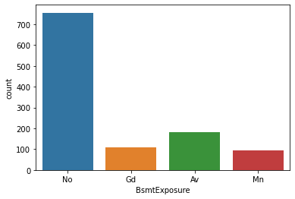
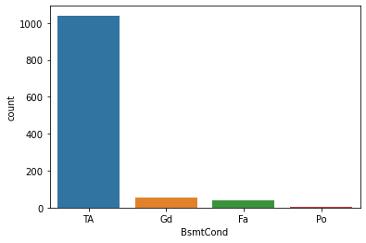
BsmtCond
Evaluates the general condition of the basement
BsmtExposure
Refers to walkout or garden level walls
1041 properties have TA (Typical - slight dampness allowed) basement condition
56 properties have Gd (good) basement condition
39 properties have Fa (fair - dampness or some cracking or settling) basement condition
2 properties have Po (poor - severe cracking, settling, or wetness) basement condition
30 properties have No Basement
No 756 properties No (do not have any exposure )
Av 180 properties have Av (Average Exposure (split levels or foyers typically score average or above))
Gd 108 properties have Gd (good) exposure
Mn 93 properties have Mn (minimum) exposure
31 properties have No basement
Encoding object data in numeric using Label Encoder
Encoding object data in numeric using Label Encoder

Slide 27
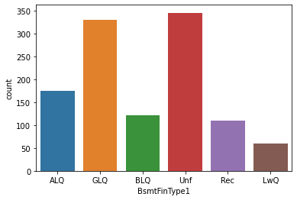
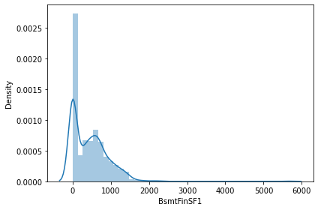
BsmtFinType1
Rating of basement finished area
BsmtFinSF1
Type 1 finished square feet
Unf 345 properties have Unf (unfinished) basement
GLQ 330 properties have GLQ (good living quarters) basement
ALQ 174 properties have ALQ (average living quarters) basement
BLQ 121 properties have BLQ (below average living quarters) basement
Rec 109 properties have Rec (average rec room) basement
LwQ 59 properties have LwQ (low quality) basement
30 properties have No basement
375 properties have no basements
The data is skewed and will be transformed later
Encoding object data in numeric using Label Encoder

Slide 28
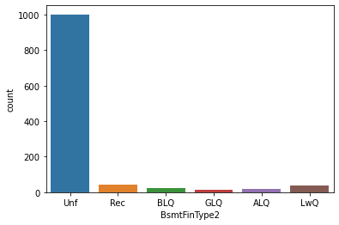
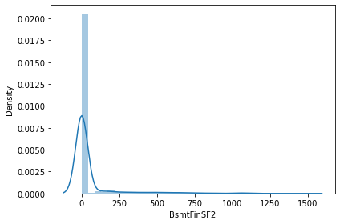
BsmtFinType2
Rating of basement finished area (if multiple types)
BsmtFinSF2
Type 2 finished square feet
Unf 1002 properties have Unf (unfinished) basements
Rec 43 properties have Rec (Average Rec Room) basement
LwQ 40 properties have LwQ (Low Quality) basement
BLQ 24 properties have BLQ (Below Average Living Quarters) basements
ALQ 16 properties have ALQ (Average Living Quarters)
GLQ 12 properties have GLQ (Good Living Quarters)
31 properties have No basement
1032 have no basements or unfinished basements
The data is skewed and will be transformed later
Encoding object data in numeric using Label Encoder

Slide 29
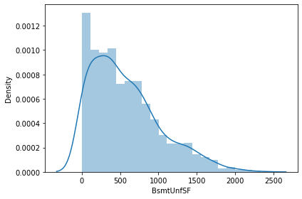
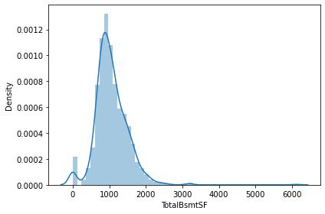
BsmtUnfSF
Unfinished square feet of basement area
TotalBsmtSF
Total square feet of basement area
97 basements are finished, hence BsmtInfSF is 0
30 properties have no basements, hence TotalBsmtSf is 0
The data is slightly skewed and will be transformed later
The data is skewed and will be transformed later

Slide 30
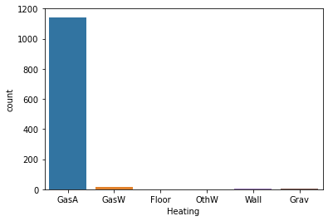
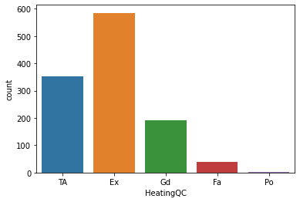
Heating
Type of heating
HeatingQC
Heating quality and condition
1143 properties have GasA (Gas forced warm air furnace) heating
14 properties have GasW (Gas hot water or steam heat) heating
5 properties have Grav (Gravity furnace) heating
4 properties have Wall furnace heating
1 property has Floor furnace heating
1 property has OthW (Hot water or steam heat other than gas)
585 properties have Ex (Excellent) heating
352 properties have TA (Average/typical) heating
192 properties have Gd (good) heating
38 properties have Fa (Fair) heating
1 property has Po (Poor) heating
Encoding object data in numeric using Label Encoder
Encoding object data in numeric using Label Encoder

Slide 31
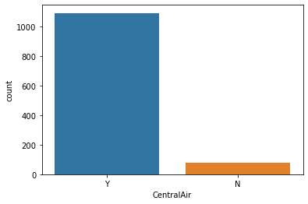
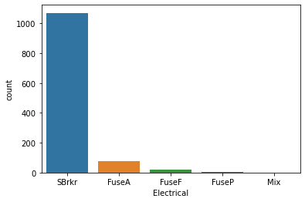
CentralAir
Central air conditioning
Electrical
Electrical system
1070 properties have SBrkr(Standard Circuit Breakers & Romex) electrical system
74 properties have FuseA (Fuse Box over 60 AMP and all Romex wiring (Average) ) electrical system
21 properties have FuseF (60 AMP Fuse Box and mostly Romex wiring (Fair)) electrical system
2 properties has FuseP (60 AMP Fuse Box and mostly knob & tube wiring (poor)) electrical system
1 property has Mixed electrical system
1090 properties have central air conditioning
78 properties do not have central air conditioning
Encoding object data in numeric using Label Encoder
Encoding object data in numeric using Label Encoder

Slide 32
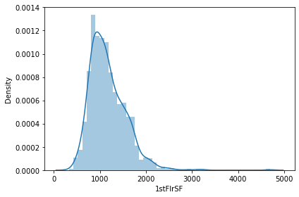
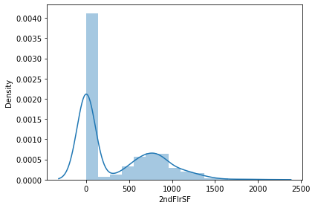
1stFlrSF
First Floor square feet
2ndFlrSF
Second floor square feet
19 properties have 864 sq ft for first floor
663 properties do not have second floor, hence 2ndFlrSF is 0
The data is slightly skewed and will be transformed later
The data is skewed and will be transformed later

Slide 33
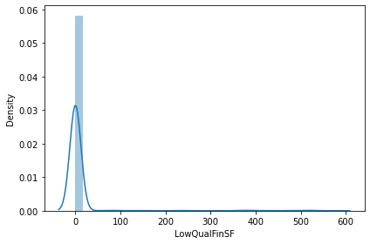
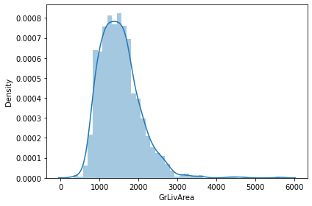
LowQualFinSF
Low quality finished square feet (all floors)
GrLivArea
Above grade (ground) living area square feet
1145 properties do not have any low quality finished square feet
18 properties have 864 sq ft above grade (ground) living area
The data is skewed and will be transformed later
The data is skewed and will be transformed later

Slide 34
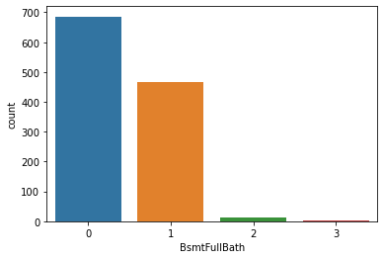
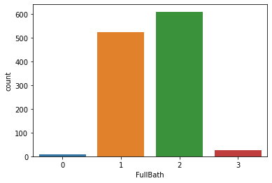
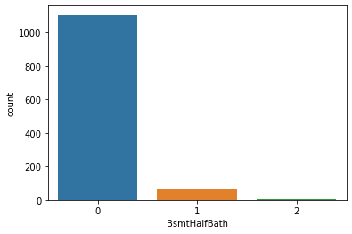

BsmtFullBath
Basement full bathrooms
FullBath
Full bathrooms above grade
686 properties have no basement full bathrooms
468 properties have 1 basement full bathroom
13 properties have 2 basement full bathrooms
1 property has 3 basement full bathrooms
610 properties have 2 full bathrooms above grade
524 properties have 1 full bathrooms above grade
27 properties have 3 full bathrooms above grade
7 properties have no full bathrooms above grade
BsmtHalfBath
Basement half bathrooms
HalfBath
Half baths above grade
1105 properties have no basement half bathrooms
61 properties have 1 basement full bathroom
2 properties have 2 basement full bathrooms
724 properties have no full bathrooms above grade
434 properties have 1full bathroom above grade
10 properties have 2 full bathrooms above grade

Slide 35


BedroomAbvGr
Bedrooms above grade (does NOT include basement bedrooms)
KitchenAbvGr
Kitchens above grade
640 properties have 3 bedrooms above grade
281 properties have 2 bedrooms above grade
180 properties have 4 bedrooms above grade
39 properties have 1 bedroom above grade
18 properties have 5 bedrooms above grade
5 properties have 6 bedrooms above grade
4 properties have no bedrooms above grade
1 property has 8 bedrooms above grade
1114 properties have 1 kitchen above grade
52 properties have 2 kitchen above grade
1 property has 3 kitchen above grade
1 properties has no kitchen above grade

Slide 36


KitchenQual
Kitchen quality
TotRmsAbvGrd
Total rooms above grade (does not include bathrooms)
578 properties have TA (typical) kitchen
478 properties have Gd (good) kitchen
82 properties have Ex (excellent) kitchen
30 properties have Fa (fair) kitchen
325 properties have total 6 rooms above grade
268 properties have total 7 rooms above grade
217 properties have total 5 rooms above grade
148 properties have total 8 rooms above grade
72 properties have total 4 rooms above grade
65 properties have total 9 rooms above grade
41 properties have total 10 rooms above grade
13 properties have total 11 rooms above grade
11 properties have total 3 rooms above grade
6 properties have total 12 rooms above grade
1 property has total 2 rooms above grade
1 property has total 14 rooms above grade
Encoding object data in numeric using Label Encoder

Slide 37


Functional
Home functionality (Assume typical unless deductions are warranted)
Fireplaces
Number of fireplaces
1085 properties have Typ (Typical Functionality)
30 properties have Min2 (Minor Deductions 2)
25 properties have Min1 (Minor Deductions 1)
12 properties have Mod (Moderate Deductions)
11 properties have Maj1 (Major Deductions 1)
4 properties have Maj2 (Major Deductions 2)
1 property has Sev (Severely Damaged)
551 properties have no fireplace
518 properties have 1 fireplace
94 properties have 2 fireplaces
5 properties have 2 fireplaces
Encoding object data in numeric using Label Encoder

Slide 38


FireplaceQu
Fireplace quality
GarageType
Garage location
691 properties have Attchd (Attached to home) garage
314 properties have Detchd (Detached from home) garage
70 properties have BuiltIn (Built-In (Garage part of house - typically has room above garage)) garage
16 properties have Basment garage
8 properties have CarPort garage
5 properties have 2Types (More than one type of garage) garage
64 properties have no garage
301 properties have Gd (good) fireplace
252 properties have TA (typical) fireplace
25 properties have Fa (fair) fireplace
21 properties have Ex (excellent) fireplace
18 properties have Po (poor) fireplace
551 properties have no fireplace
Encoding object data in numeric using Label Encoder
Encoding object data in numeric using Label Encoder

Slide 39


GarageYrBlt
Year garage was built
GarageFinish
Interior finish of the garage
Majority of the garages were built in the year 2000
487 properties have Unf (Unfinished) garage
339 properties have RFn (Rough Finished) garage
278 properties have Fin (Finished) garage
64 properties have no garage
64 properties do not have garages, hence those null values are replaced by 0
Encoding object data in numeric using Label Encoder

Slide 40


GarageCars
Size of garage in car capacity
GarageArea
Size of garage in square feet
665 properties have garage capacity for 2 cars
288 properties have garage capacity for 1 car
147 properties have garage capacity for 3 cars
64 properties have no garage capacity
4 properties have garage capacity for 4 cars
64 properties have no garage
44 properties have garage area of 440 sq ft
The data is skewed and will be transformed later

Slide 41


GarageQual
Garage quality
GarageCond
Garage condition
1050 properties have TA (typical) garage
39 properties have Fa (fair) garage
11 properties have Gd (good) garage
2 properties have Ex (excellent) garage
2 properties have Po (poor) garage
64 properties do not have garage
1061 properties have TA (typical) garage
28 properties have Fa (fair) garage
8 properties have Gd (good) garage
6 properties have Po (poor) garage
1 property has Ex(excellent) garage
64 properties have no garage
Encoding object data in numeric using Label Encoder
Encoding object data in numeric using Label Encoder

Slide 42


PavedDrive
Paved driveway
WoodDeckSF
Wood deck area in square feet
Y 1071 properties have Y (paved) driveway
N 74 properties have N (dirt/gravel) driveway
P 23 properties (P) have partial pavement driveway
603 properties do not have wood deck, hence WoodDeskSF is 0
The data is skewed and will be transformed later
Encoding object data in numeric using Label Encoder

Slide 43


OpenPorchSF
Open porch area in square feet
EnclosedPorch
Enclosed porch area in square feet
531 properties do not have any porch, hence OpenPorchSF is 0
999 properties do not have enclosed porch, hence EnclosedPorch are is 0
The data is skewed and will be transformed later
The data is skewed and will be transformed later

Slide 44


ScreenPorch
Screen porch area in square feet
3SsnPorch
Three season porch area in square feet
1146 properties do not have three season porch, hence 3SsnPorch is 0
1073 properties do not have screenporch, hence ScreenPorch is 0
The data is skewed and will be transformed later
The data is skewed and will be transformed later

Slide 45


PoolArea
Pool area in square feet
PoolQC
Pool quality
1161 properties do not have pool, hence PoolArea is 0
3 properties have Gd (Good) pool
2 properties have Ex(Excellent) pool
2 properties have Fa (fair) pool
1161 properties do not have a pool
The data is skewed and will be transformed later
Encoding object data in numeric using Label Encoder

Slide 46


MiscFeature
Miscellaneous feature not covered in other categories
Fence
Fence quality
129 properties have MnPrv (Minimum Privacy) fence
51 properties have GdPrv (Good Privacy) fence
47 properties have GdWo (Good Wood) fence
10 properties have MnWw (Minimum Wood/Wire) fence
931 properties do not have any fence
40 properties have Shed (over 100 SF)
2 properties have Gar2 (2nd Garage (if not described in garage section)
1 property has TenC (Tennis Court)
1 property has Othr
1124 properties do not have miscellaneous feature
Encoding object data in numeric using Label Encoder
Encoding object data in numeric using Label Encoder

Slide 47



MoSold
Month Sold (MM)
MiscVal
$Value of miscellaneous feature
Majority of the properties are sold in June
YrSold
Year Sold (YYYY)
1126 properties do not have miscellaneous features hence MiscVal is 0
The data is skewed and will be transformed later
Majority of the properties are sold between 2006-2009

Slide 48


SaleCondition
Condition of sale
SaleType
Type of sale
999 properties are WD (Warranty Deed – Conventional)
106 properties are New (Home just constructed and sold)
38 properties are COD (Court Officer Deed/Estate)
8 properties are ConLD (Contract Low Down)
5 properties are ConLI (Contract Low Interest)
4 properties are ConLw (Contract Low Down payment and low interest)
3 properties are other
3 properties are CWD (Warranty Deed – Cash)
2 properties are Con (Contract 15% Down payment regular terms)
945 properties had Normal sale
108 properties had Partial (Home was not completed when last assessed (associated with New Homes)) sale
81 properties had Abnormal (trade, foreclosure, short sale) sale
18 properties had Family (Sale between family members) sale
12 properties had Alloca (Allocation - two linked properties with separate deeds, typically condo with a garage unit)
4 properties had AdjLand (Adjoining Land Purchase) sale
Encoding object data in numeric using Label Encoder
Encoding object data in numeric using Label Encoder

Slide 49

LABEL
SalePrice
18 properties have a sale price of 140000

Slide 50
The null values in 'LotFrontage‘ and 'MasVnrArea‘ are imputed using KNN Imputer.
Statistical analysis using describe method-

Slide 51
MSSubClass
count 1168.000000
mean 56.767979
std 41.940650
min 20.000000
25% 20.000000
50% 50.000000
75% 70.000000
max 190.000000
MSZoning
count 1168.000000
mean 3.013699
std 0.633120
min 0.000000
25% 3.000000
50% 3.000000
75% 3.000000
max 4.000000
LotFrontage
count 1168.000000
mean 71.724315
std 24.159328
min 21.000000
25% 60.000000
50% 70.000000
75% 81.000000
max 313.000000
LotArea
count 1168.000000
mean 10484.749144
std 8957.442311
min 1300.000000
25% 7621.500000
50% 9522.500000
75% 11515.500000
max 164660.000000
Street
count 1168.000000
mean 0.996575
std 0.058445
min 0.000000
25% 1.000000
50% 1.000000
75% 1.000000
max 1.000000
Alley
count 1168.000000
mean 1.898973
std 0.401453
min 0.000000
25% 2.000000
50% 2.000000
75% 2.000000
max 2.000000
LotShape
count 1168.000000
mean 1.938356
std 1.412262
min 0.000000
25% 0.000000
50% 3.000000
75% 3.000000
max 3.000000
LandContour
count 1168.000000
mean 2.773973
std 0.710027
min 0.000000
25% 3.000000
50% 3.000000
75% 3.000000
max 3.000000
LotConfig
count 1168.000000
mean 3.004281
std 1.642667
min 0.000000
25% 2.000000
50% 4.000000
75% 4.000000
max 4.000000
LandSlope
count 1168.000000
mean 0.064212
std 0.284088
min 0.000000
25% 0.000000
50% 0.000000
75% 0.000000
max 2.000000
Neighborhood
count 1168.000000
mean 12.145548
std 6.010364
min 0.000000
25% 7.000000
50% 12.000000
75% 17.000000
max 24.000000
Condition1
count 1168.000000
mean 2.032534
std 0.871703
min 0.000000
25% 2.000000
50% 2.000000
75% 2.000000
max 8.000000

Slide 52
Condition2
count 1168.000000
mean 2.005993
std 0.250035
min 0.000000
25% 2.000000
50% 2.000000
75% 2.000000
max 7.000000
BldgType
count 1168.000000
mean 0.476027
std 1.180870
min 0.000000
25% 0.000000
50% 0.000000
75% 0.000000
max 4.000000
HouseStyle
count 1168.000000
mean 3.043664
std 1.898625
min 0.000000
25% 2.000000
50% 2.000000
75% 5.000000
max 7.000000
OverallQual
count 1168.000000
mean 6.104452
std 1.390153
min 1.000000
25% 5.000000
50% 6.000000
75% 7.000000
max 10.000000
OverallCond
count 1168.000000
mean 5.595890
std 1.124343
min 1.000000
25% 5.000000
50% 5.000000
75% 6.000000
max 9.000000
YearBuilt
count 1168.000000
mean 1970.930651
std 30.145255
min 1875.000000
25% 1954.000000
50% 1972.000000
75% 2000.000000
max 2010.000000
YearRemodAdd
count 1168.000000
mean 1984.758562
std 20.785185
min 1950.000000
25% 1966.000000
50% 1993.000000
75% 2004.000000
max 2010.000000
RoofStyle
count 1168.000000
mean 1.402397
std 0.832539
min 0.000000
25% 1.000000
50% 1.000000
75% 1.000000
max 5.000000
RoofMatl
count 1168.000000
mean 1.086473
std 0.642848
min 0.000000
25% 1.000000
50% 1.000000
75% 1.000000
max 7.000000
Exterior1st
count 1168.000000
mean 8.659247
std 3.097443
min 0.000000
25% 7.000000
50% 11.000000
75% 11.000000
max 13.000000
Exterior2nd
count 1168.000000
mean 9.363014
std 3.462380
min 0.000000
25% 7.000000
50% 11.000000
75% 12.000000
max 14.000000
MasVnrType
count 1168.000000
mean 1.758562
std 0.611174
min 0.000000
25% 1.000000
50% 2.000000
75% 2.000000
max 3.000000

Slide 53
MasVnrArea
count 1168.000000
mean 102.576199
std 182.350310
min 0.000000
25% 0.000000
50% 0.000000
75% 160.000000
max 1600.000000
ExterQual
count 1168.000000
mean 2.530822
std 0.699425
min 0.000000
25% 2.000000
50% 3.000000
75% 3.000000
max 3.000000
ExterCond
count 1168.000000
mean 3.725171
std 0.744463
min 0.000000
25% 4.000000
50% 4.000000
75% 4.000000
max 4.000000
Foundation
count 1168.000000
mean 1.395548
std 0.709379
min 0.000000
25% 1.000000
50% 1.000000
75% 2.000000
max 5.000000
BsmtQual
count 1168.000000
mean 2.308219
std 0.893201
min 0.000000
25% 2.000000
50% 2.000000
75% 3.000000
max 4.000000
BsmtCond
count 1168.000000
mean 2.827911
std 0.700355
min 0.000000
25% 3.000000
50% 3.000000
75% 3.000000
max 4.000000
BsmtExposure
count 1168.000000
mean 2.299658
std 1.172054
min 0.000000
25% 2.000000
50% 3.000000
75% 3.000000
max 4.000000
BsmtFinType1
count 1168.000000
mean 2.824486
std 1.875065
min 0.000000
25% 1.000000
50% 2.000000
75% 5.000000
max 6.000000
BsmtFinSF1
count 1168.000000
mean 444.726027
std 462.664785
min 0.000000
25% 0.000000
50% 385.500000
75% 714.500000
max 5644.000000
BsmtFinType2
count 1168.000000
mean 4.739726
std 0.947136
min 0.000000
25% 5.000000
50% 5.000000
75% 5.000000
max 6.000000
BsmtFinSF2
count 1168.000000
mean 46.647260
std 163.520016
min 0.000000
25% 0.000000
50% 0.000000
75% 0.000000
max 1474.000000
BsmtUnfSF
count 1168.000000
mean 569.721747
std 449.375525
min 0.000000
25% 216.000000
50% 474.000000
75% 816.000000
max 2336.000000

Slide 54
TotalBsmtSF
count 1168.000000
mean 1061.095034
std 442.272249
min 0.000000
25% 799.000000
50% 1005.500000
75% 1291.500000
max 6110.000000
Heating
count 1168.000000
mean 1.035959
std 0.302078
min 0.000000
25% 1.000000
50% 1.000000
75% 1.000000
max 5.000000
HeatingQC
count 1168.000000
mean 1.569349
std 1.749129
min 0.000000
25% 0.000000
50% 0.000000
75% 4.000000
max 4.000000
CentralAir
count 1168.000000
mean 0.933219
std 0.249749
min 0.000000
25% 1.000000
50% 1.000000
75% 1.000000
max 1.000000
Electrical
count 1168.000000
mean 3.688356
std 1.042606
min 0.000000
25% 4.000000
50% 4.000000
75% 4.000000
max 4.000000
1stFlrSF
count 1168.000000
mean 1169.860445
std 391.161983
min 334.000000
25% 892.000000
50% 1096.500000
75% 1392.000000
max 4692.000000
2ndFlrSF
count 1168.000000
mean 348.826199
std 439.696370
min 0.000000
25% 0.000000
50% 0.000000
75% 729.000000
max 2065.000000
LowQualFinSF
count 1168.000000
mean 6.380137
std 50.892844
min 0.000000
25% 0.000000
50% 0.000000
75% 0.000000
max 572.000000
GrLivArea
count 1168.000000
mean 1525.066781
std 528.042957
min 334.000000
25% 1143.250000
50% 1468.500000
75% 1795.000000
max 5642.000000
BsmtFullBath
count 1168.000000
mean 0.425514
std 0.521615
min 0.000000
25% 0.000000
50% 0.000000
75% 1.000000
max 3.000000
BsmtHalfBath
count 1168.000000
mean 0.055651
std 0.236699
min 0.000000
25% 0.000000
50% 0.000000
75% 0.000000
max 2.000000
FullBath
count 1168.000000
mean 1.562500
std 0.551882
min 0.000000
25% 1.000000
50% 2.000000
75% 2.000000
max 3.000000

Slide 55
HalfBath
count 1168.000000
mean 0.388699
std 0.504929
min 0.000000
25% 0.000000
50% 0.000000
75% 1.000000
max 2.000000
BedroomAbvGr
count 1168.000000
mean 2.884418
std 0.817229
min 0.000000
25% 2.000000
50% 3.000000
75% 3.000000
max 8.000000
KitchenAbvGr
count 1168.000000
mean 1.045377
std 0.216292
min 0.000000
25% 1.000000
50% 1.000000
75% 1.000000
max 3.000000
KitchenQual
count 1168.000000
mean 2.328767
std 0.832992
min 0.000000
25% 2.000000
50% 2.000000
75% 3.000000
max 3.000000
TotRmsAbvGrd
count 1168.000000
mean 6.542808
std 1.598484
min 2.000000
25% 5.000000
50% 6.000000
75% 7.000000
max 14.000000
Functional
count 1168.000000
mean 5.742295
std 0.987250
min 0.000000
25% 6.000000
50% 6.000000
75% 6.000000
max 6.000000
Fireplaces
count 1168.000000
mean 0.617295
std 0.650575
min 0.000000
25% 0.000000
50% 1.000000
75% 1.000000
max 3.000000
FireplaceQu
count 1168.000000
mean 3.804795
std 1.400665
min 0.000000
25% 2.000000
50% 4.000000
75% 5.000000
max 5.000000
GarageType
count 1168.000000
mean 2.499144
std 1.935551
min 0.000000
25% 1.000000
50% 1.000000
75% 5.000000
max 6.000000
GarageYrBlt
count 1168.000000
mean 1869.799658
std 451.037303
min 0.000000
25% 1957.750000
50% 1977.000000
75% 2001.000000
max 2010.000000
GarageFinish
count 1168.000000
mean 1.288527
std 0.889704
min 0.000000
25% 1.000000
50% 1.000000
75% 2.000000
max 3.000000
GarageCars
count 1168.000000
mean 1.776541
std 0.745554
min 0.000000
25% 1.000000
50% 2.000000
75% 2.000000
max 4.000000

Slide 56
GarageArea
count 1168.000000
mean 476.860445
std 214.466769
min 0.000000
25% 338.000000
50% 480.000000
75% 576.000000
max 1418.000000
GarageQual
count 1168.000000
mean 3.927226
std 0.645872
min 0.000000
25% 4.000000
50% 4.000000
75% 4.000000
max 5.000000
GarageCond
count 1168.000000
mean 3.960616
std 0.561694
min 0.000000
25% 4.000000
50% 4.000000
75% 4.000000
max 5.000000
PavedDrive
count 1168.000000
mean 1.853596
std 0.501894
min 0.000000
25% 2.000000
50% 2.000000
75% 2.000000
max 2.000000
WoodDeckSF
count 1168.000000
mean 96.206336
std 126.158988
min 0.000000
25% 0.000000
50% 0.000000
75% 171.000000
max 857.000000
OpenPorchSF
count 1168.000000
mean 46.559932
std 66.381023
min 0.000000
25% 0.000000
50% 24.000000
75% 70.000000
max 547.000000
EnclosedPorch
count 1168.000000
mean 23.015411
std 63.191089
min 0.000000
25% 0.000000
50% 0.000000
75% 0.000000
max 552.000000
3SsnPorch
count 1168.000000
mean 3.639555
std 29.088867
min 0.000000
25% 0.000000
50% 0.000000
75% 0.000000
max 508.000000
ScreenPorch
count 1168.000000
mean 15.051370
std 55.080816
min 0.000000
25% 0.000000
50% 0.000000
75% 0.000000
max 480.000000
PoolArea
count 1168.000000
mean 3.448630
std 44.896939
min 0.000000
25% 0.000000
50% 0.000000
75% 0.000000
max 738.000000
PoolQC
count 1168.000000
mean 2.988870
std 0.157245
min 0.000000
25% 3.000000
50% 3.000000
75% 3.000000
max 3.000000
Fence
count 1168.000000
mean 3.475171
std 1.112090
min 0.000000
25% 4.000000
50% 4.000000
75% 4.000000
max 4.000000

Slide 57
MiscFeature
count 1168.000000
mean 3.921233
std 0.408514
min 0.000000
25% 4.000000
50% 4.000000
75% 4.000000
max 4.000000
MiscVal
count 1168.000000
mean 47.315068
std 543.264432
min 0.000000
25% 0.000000
50% 0.000000
75% 0.000000
max 15500.000000
MoSold
count 1168.000000
mean 6.344178
std 2.686352
min 1.000000
25% 5.000000
50% 6.000000
75% 8.000000
max 12.000000
YrSold
count 1168.000000
mean 2007.804795
std 1.329738
min 2006.000000
25% 2007.000000
50% 2008.000000
75% 2009.000000
max 2010.000000
SaleType
count 1168.000000
mean 7.465753
std 1.619459
min 0.000000
25% 8.000000
50% 8.000000
75% 8.000000
max 8.000000
SaleCondition
count 1168.000000
mean 3.768836
std 1.112208
min 0.000000
25% 4.000000
50% 4.000000
75% 4.000000
max 5.000000
SalePrice
count 1168.000000
mean 181477.005993
std 79105.586863
min 34900.000000
25% 130375.000000
50% 163995.000000
75% 215000.000000
max 755000.000000

Slide 58
Correlation between the columns and the label ‘Sale Price’ using corr method-
SalePrice 1.000000
OverallQual 0.789185
GrLivArea 0.707300
GarageCars 0.628329
GarageArea 0.619000
...
FireplaceQu -0.445910
GarageFinish -0.550624
KitchenQual -0.592468
ExterQual -0.624820
BsmtQual -0.628798
OverallQual is 78% positively correlated to ‘Sale Price’
GrLivArea is 70% positively correlated to ‘Sale Price’
GarageCars is 62% positively correlated to ‘Sale Price’
GarageArea is 61% positively correlated to ‘Sale Price’
Fireplace is 44% negatively correlated to ‘Sale Price’
GarageFinish is 55% negatively correlated to ‘Sale Price’
KitchenQual is 59% negatively correlated to ‘Sale Price’
ExterQual and BsmtQual is 62% negatively correlated to ‘Sale Price’

Slide 59

Visualizing outliers using boxplot method-

Slide 60


Slide 61
Removing outliers using zscore method-
On removing the outliers the data loss is 62.58%, which is not acceptable, hence outliers are tolerated
The dataset is divided into x_train (features) and y_train (label)-
The x_train contains all the features other than the label ‘Sale Price’
The y_train contains only the label ‘Sale Price’

Slide 62

Visualizing relationship between features and label-

Slide 63


Slide 64
Selecting Best Features using SelectPercentile and chi2-
Hereby, top 80% features are retrieved, as follows-
MSSubClass
LotFrontage
LotArea
LotShape
LandContour
LotConfig
LandSlope
Neighborhood
Condition1
BldgType
HouseStyle
OverallQual
OverallCond
YearBuilt
YearRemodAdd
TotalBsmtSF
HeatingQC
Electrical
1stFlrSF
2ndFlrSF
LowQualFinSF
GrLivArea
BsmtFullBath
BsmtHalfBath
FullBath
HalfBath
BedroomAbvGr
KitchenQual
TotRmsAbvGrd
Fireplaces
FireplaceQu
GarageType
GarageYrBlt
GarageFinish
GarageCars
GarageArea
WoodDeckSF
OpenPorchSF
EnclosedPorch
3SsnPorch
ScreenPorch
PoolArea
Fence
MiscVal
MoSold
SaleType
SaleCondition
RoofStyle
RoofMatl
Exterior1st
Exterior2nd
MasVnrType
MasVnrArea
ExterQual
Foundation
BsmtQual
BsmtCond
BsmtExposure
BsmtFinType1
BsmtFinSF1
BsmtFinSF2
BsmtUnfSF
These features are then set as x_train

Slide 65
The skewness observes in graphical analysis was confirmed by using the skew method-
MiscVal 23.065943
PoolArea 13.243711
LotArea 10.659285
3SsnPorch 9.770611
LowQualFinSF 8.666142
...
BsmtCond -2.927336
Electrical -3.104209
LandContour -3.125982
SaleType -3.660513
GarageYrBlt -3.898694
This skewness was removed using the power transformer
The x_train is now composed of 1168 rows and 62 columns

Slide 66
The test datasheet and saved in another dataframe
From the above datasheet, x_test is extracted containing only the best features obtained and stored in x_train.
The shape of x_test is 292 rows and 62 columns

Slide 67
The data types of the columns are-
MSSubClass ---------------- int64
LotFrontage ---------------- float64
LotArea ---------------- int64
LotShape ---------------- object
LandContour ---------------- object
LotConfig ---------------- object
LandSlope ---------------- object
Neighborhood ---------------- object
Condition1 ---------------- object
BldgType ---------------- object
HouseStyle ---------------- object
OverallQual ---------------- int64
OverallCond ---------------- int64
YearBuilt ---------------- int64
YearRemodAdd ---------------- int64
RoofStyle ---------------- object
RoofMatl ---------------- object
Exterior1st ---------------- object
Exterior2nd ---------------- object
MasVnrType ---------------- object
MasVnrArea ---------------- float64
ExterQual ---------------- object
Foundation ---------------- object
BsmtQual ---------------- object
BsmtCond ---------------- object
BsmtExposure ---------------- object
BsmtFinType1 ---------------- object
BsmtFinSF1 ---------------- int64
BsmtFinSF2 ---------------- int64
BsmtUnfSF ---------------- int64
TotalBsmtSF ---------------- int64
HeatingQC ---------------- object
Electrical ---------------- object
1stFlrSF ---------------- int64
2ndFlrSF ---------------- int64 L
owQualFinSF ---------------- int64
GrLivArea ---------------- int64
BsmtFullBath ---------------- int64
BsmtHalfBath ---------------- int64
FullBath ---------------- int64
HalfBath ---------------- int64
BedroomAbvGr ---------------- int64
KitchenQual ---------------- object
TotRmsAbvGrd ---------------- int64
Fireplaces ---------------- int64
FireplaceQu ---------------- object
GarageType ---------------- object
GarageYrBlt ---------------- float64
GarageFinish ---------------- object
GarageCars ---------------- int64
GarageArea ---------------- int64
WoodDeckSF ---------------- int64
OpenPorchSF ---------------- int64
EnclosedPorch ---------------- int64
3SsnPorch ---------------- int64
ScreenPorch ---------------- int64
PoolArea ---------------- int64
Fence ---------------- object
MiscVal ---------------- int64
MoSold ---------------- int64
SaleType ---------------- object
SaleCondition ----------------object

Slide 68
The null values are present in the following columns-
Column | No of null values
LotFrontage | 45
MasVnrType | 1
MasVnrArea | 1
BsmtQual | 7
BsmtCond | 7
BsmtExposure | 7
BsmtFinType1 | 7
FireplaceQu | 139
GarageType | 17
GarageYrBlt | 17
GarageFinish | 17
Fence | 248

Slide 69
Encoding object data in numeric using Label Encoder
In MasVnrType the null value is replaced by the mode of the column
In GarageYrBlt, the null values are actually for properties lacking garages, hence null values are filled with 0
The null values of LotFrontage and MasVnrArea are imputed using KNN Imputer

Slide 70
The skewness is observed using the skew method-
RoofMatl 13.717569
MiscVal 13.264758
LotArea 12.781805
3SsnPorch 12.277476
LowQualFinSF 10.929928
...
Electrical -2.955201
BsmtCond -3.085864
LandContour -3.332422
GarageYrBlt -3.776995
SaleType -5.489874
This skewness was removed using the power transformer
The x_test is now composed of 292 rows × 62 columns

Slide 71
The x_train, y_train and x_test were applied on different models as follows

Slide 72
Linear Regression Model
The R2 score for y_train and pred_train (data predicted on x_train) is 83.13%
Upon cross-validation it was observed that the number of folds did not have such impact on the accuracy and cv score. So cv=8 is selected. Here we have handled the problem of the overfitting and the underfitting by checking the training and testing score
The graph between Actual Price and Predicted Price depicts the best fit line which passes through maximum of the points, hence suggesting that the model works well-

Slide 73


Slide 74
The Linear Regression Model is Lasso regularized with the aid of GridSearchCV
The best parameters for alpha and random_state are found as follows-
alpha: 10
random_state: 0
Applying the above found best parameters on Lasso regularized Linear Regression Model, the following was obtained-
R2 score for y_train and pred_train (data predicted on x_train) – 83.13%
CV score- 77.93%

Slide 75
Random Forest Regressor Model
Random Forest Regressor Model is hyperparameter tuned using GridSearchCV
The best parameters for criterion and max_features are found as follows-
criterion: mse
max_features: sqrt
Applying the above found best parameters on Random Forest Regressor Model, the following was obtained-
R2 score for y_train and pred_train (data predicted on x_train) –97.90%
CV score- 85.41%

Slide 76
Ada Boost Regressor Model
Ada Boost Regressor Model is hyperparameter tuned using GridSearchCV
The best parameters for n_estimators and learning_rate are found as follows-
learning_rate: 0.01
n_estimators: 76
Applying the above found best parameters on Ada Boost Regressor Model, the following was obtained-
R2 score for y_train and pred_train (data predicted on x_train) –79.69%
CV score- 73.73%

Slide 77
Model | R2 score for y_train and pred_train (data predicted on x_train) | CV score
Linear Regression Model | 83.13% | 77.93%
Random Forest Regressor Model | 97.90% | 85.41%
AdaBoost Regressor Model | 79.69% | 73.73%

Slide 78
The R2 score of Random Forest Regressor 97.91% is and CV score of Random Forest Regressor is 85.41%. This is the best working model and is finalized
The test data (x_test) is fit into the Random Forest Regressor Model, and the prices are predicted for the various properties
Surprise Housing can now assess whether the property is good for their business or not

